Slide 1
Branching Strategy #1
“Easy Peasy”
Rule – New development in trunk.
Rule – Release from trunk.
Rule – Create Release Branch from trunk when patch is necessary.
Recommendation – Use when team size is less than 5.

Slide 2
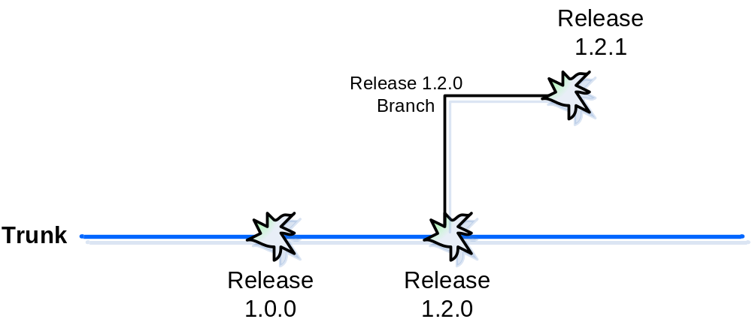

Slide 3
Branching Strategy #2
“No Junk in the Trunk”
Trunk Policy – Only “Done” things in the trunk.
Assumption – “Done” means releasable.
Recommendation – Only create a new branch when you have something you want to check in, and there is no existing branch you can use without violating its policy.

Slide 4
Work Branches
Branch Policy – All code compiles.
Assumption – Code may not work, and may not be tested.
Recommendation – Check in to this branch at a minimum of once per day.

Slide 5
Release Branches
Rule – Only code to patch releases go here.
Rule – Merge from release branch to trunk immediately after releasing.
Rule – No NEW features
Recommendation – Only create a release branch if a patch is necessary.

Slide 6
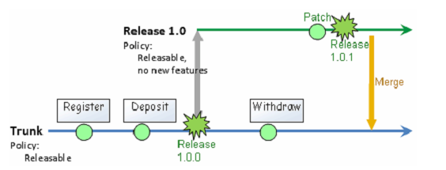

Slide 7
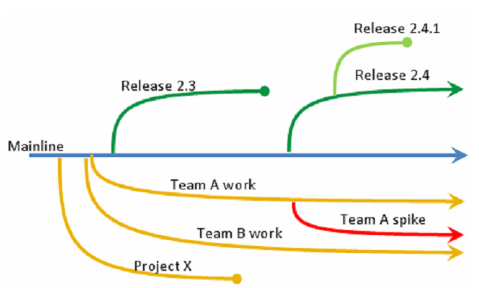

Slide 8
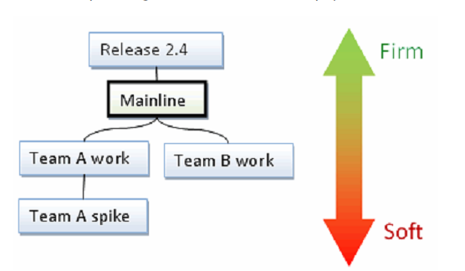

Slide 9
